Slide 1
LESSON 17: Raising Lazarus The Life Of Christ – Perea to Bethany
John 11:1-53
December 8, 2021

Slide 2
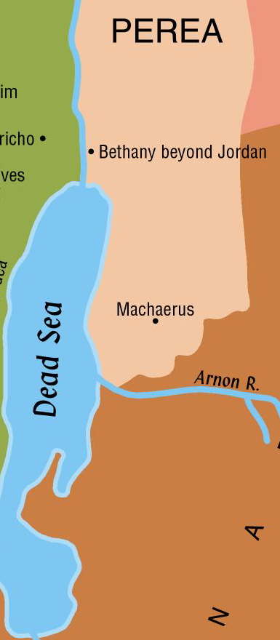
The Life of Christ
Perea
Name does not appear in the Bible
Comes from the Greek word meaning “beyond”
Perea is the land “beyond” the Jordan (Mark 3:8)

Slide 3
The Life of Christ
Perea
Includes the narrow strip of land that once belonged to the tribes of Reuben and Gad
Called Gilead in the Old Testament
John did his baptizing there
Jesus withdrew to Perea a few weeks before His crucifixion (John 10:40-42)
John baptized in Bethany beyond Jordan (John 1:28)

Slide 4
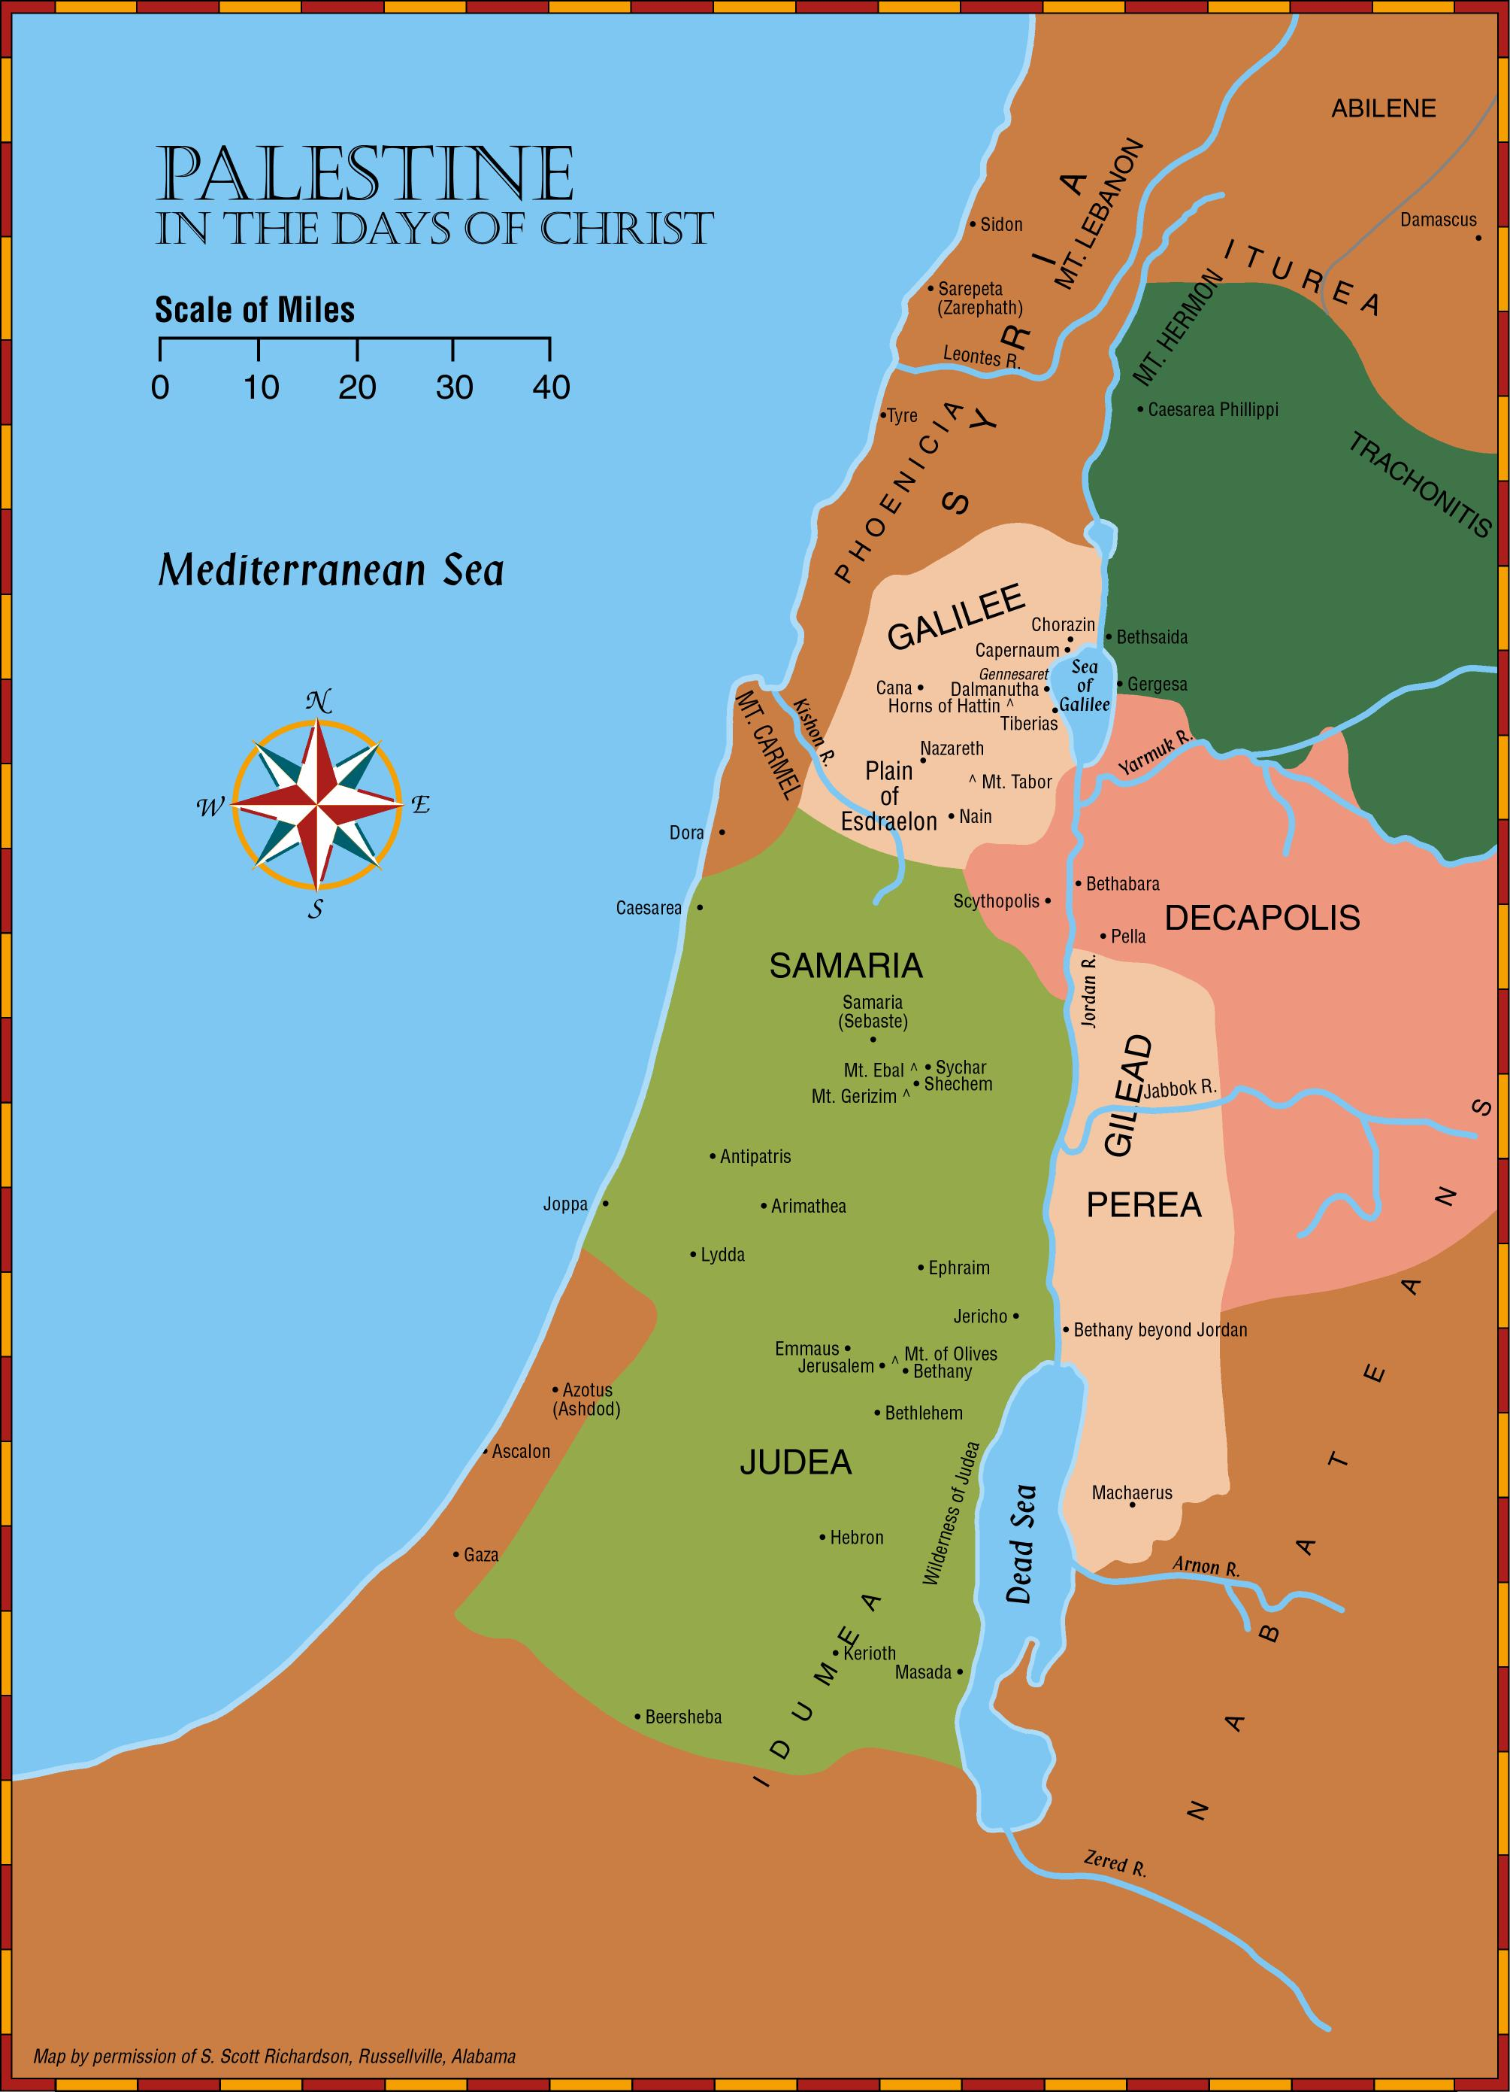
John baptized
in Aenon near to Salim, because there was much water there: (John 3:23)
John baptized in Bethany beyond Jordan (John 1:28)

Slide 5
The Raising of Lazarus John 11:23-57
A. In this chapter Jesus performed one of the most outstanding miracles of His ministry. He raised Lazarus from the dead.
1. The purpose of His miracles was “that ye might believe that Jesus is the Christ the Son of God, and that believing ye might have life in his name.” (John 20:30-31)

Slide 6
The Raising of Lazarus John 11:23-57
B. After Jesus received word that Lazarus was sick, He tarried for two more days.
1. Four days after Lazarus died, Jesus arrived in Bethany. Martha met Jesus and said, “Lord, if thou hadst been here, my brother had not died …”
a. Martha was not being critical of the Lord, but acknowledging that Jesus had the power to prevent Lazarus’ death.
b. Martha was told that Lazarus shall rise.
(1) She acknowledged that Lazarus would come forth in the resurrection. (cf. John 5:28-29; 6:39-40, 54; John 12:48)
(2) Jesus spoke to her about raising Lazarus from the dead miraculously.

Slide 7
The Raising of Lazarus John 11:23-53
Jesus replied that Lazarus would live again.
John 11:23-26 “Jesus saith unto her, Thy brother shall rise again. Martha saith unto him, I know that he shall rise again in the resurrection at the last day. Jesus said unto her, I am the resurrection, and the life: he that believeth on me, though he die, yet shall he live; and whosoever liveth and believeth on me shall never die. Believest thou this?”
Martha understood the words of Jesus to apply to the general resurrection of all “at the last day” (cf. John 5:28-29; 6:39-40,54; 12:48; cf. Mark 12:18; Acts 23:8).
Martha obviously did not expect Jesus to raise Lazarus from the dead immediately. (cf. verse 39)
Jesus talks in verse 25 of physical death (“though he were dead”) and spiritual life (“yet shall he live”), and in verse 26 of physical life (“liveth and believeth”) and spiritual death (“shall never die”).
“I am the resurrection and the life.” (cf. John 10:36; 14:6)
cf. Philippians 1:21; 2 Corinthians 4:16-5:1

Slide 8
The Raising of Lazarus John 11:23-53
Jesus replied that Lazarus would live again.
John 11:23-26, “Believest thou this?”
NOTE: Verse 27, “She saith unto him, Yea, Lord: I have believed that thou art the Christ, the Son of God, (even) he that cometh into the world.”
Not only could Jesus raise Lazarus from physical death, thus giving assurance that He can raise all men from the dead, but Jesus could provide spiritual life.
Whosoever believes in Him shall never die. (cf. John 3:16)
How can we “live and believe?”
Certainly, this involves more than faith “ONLY.” (cf. John 12:42-43)
Involves obedient faith. (James 2:14-26; Romans 6:16-18; Hebrews 5:8-9)

Slide 9
Lazarus Is Raised From The Dead. John 11:25-46
Jesus converses with Martha and Mary. John 11:27-32, “She saith unto him, Yea, Lord: I have believed that thou art the Christ, the Son of God, (even) he that cometh into the world. And when she had said this, she went away, and called Mary her sister secretly, saying, The Teacher is here, and calleth thee. And she, when she heard it, arose quickly, and went unto him. (Now Jesus was not yet come into the village, but was still in the place where Martha met him.) The Jews then who were with her in the house, and were consoling her, when they saw Mary, that she rose up quickly and went out, followed her, supposing that she was going unto the tomb to weep there. Mary therefore, when she came where Jesus was, and saw him, fell down at his feet, saying unto him, Lord, if thou hadst been here, my brother had not died.”
In verse 32 Mary expresses the same confidence in the Lord that has been expressed by Martha in verse 21.
Neither of these sisters are critical of Jesus nor do they suggest that Jesus should raise him from the dead.

